Slide 1
ROCK: A ROBUST CLUSTERING ALGORITHM FOR CATEGORICAL ATTRIBUTES
SUDIPTO GUHA et al.
In ICDE 99

Slide 2
Outline
Background Knowledge
Shortcomings of Traditional Methods
ROCK
    Introduction of Link
    Algorithm
    Time and Space Complexity
    Experiments

Slide 3
Background knowledge
Boolean attribute and Categorical attribute
  A boolean attribute corresponding to a single item in a transaction, if that item appears, the boolean attribute is set to ‘1’ or ‘0’ otherwise.
  A categorical attribute may have several values, each value can be treated as an item and represented by a boolean attribute.

Slide 4
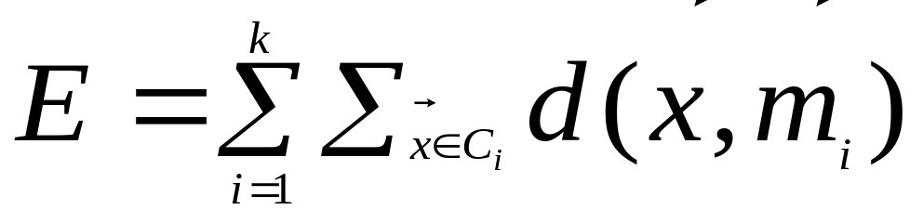
Shortcomings of Traditional methods
Traditional Clustering methods can be classified into :
  Partitional clustering which divides the point space into k clusters that optimize a certain criterion function, such as
  Hierarchical clustering which merges two clusters at each step before reaching a user defined condition

Slide 5
Shortcomings of Traditional methods
Problems of using partitional clustering
  Large number of items in database while few items in each transaction
  A pair of transactions in a cluster may only have fewer items in common
  The size of transactions is not the same
Result: partitional clustering tends to split clusters to minimize the criterion function

Slide 6
Shortcomings of Traditional methods
Problems of using hierarchical clustering
  Example of using centroid-based agglomerative hierarchical clustering
    We have 4 transactions on items 1,2,3,4,5,6
    they are: (a){1,2,3,5},(b){2,3,4,5,},(c){1,4},(d){6}
    using boolean attributes we have(a)(1,1,1,0,1,0), (b)(0,1,1,1,1,0),(c)(1,0,0,1,0,0),(d)(0,0,0,0,0,1)
After merge (a) and (b), (c ) and (d) are merged, however
they have no common items at all.

Slide 7
Shortcomings of Traditional methods
Problems of using hierarchical clustering
  Another example of using centroid-based agglomerative hierarchical clustering
    (a)(1/3,1/3,1/3,0,0,0), (b) (0,0,0,1/3,1/3,1/3) (c)(1,1,1,0,0,0) are centroids of three clusters intuitively, (a) and (c ) should be merged, however, (a) and (b) are merged because of the smaller distance between them.
    The new centroid is (1/6,1/6,1/6,1/6,1/6,1/6)
    the distance between it and (c) is even larger
    than the distance of (a) and ( c)

Slide 8
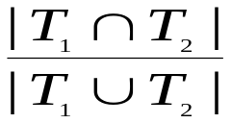
ROCK
<1,2,3,4,5> <1,2,6,7>
{1,2,3}{1,4,5} {1,2,6}
{1,2,4}{2,3,4} {1,2,7}
{1,2,5}{2,3,5} {1,6,7}
{1,3,4}{2,4,5} {2,6,7}
{1,3,5}{3,4,5}
Cluster-1 Cluster-2
Jaccard coefficient of transactions T₁ and T₂ is
{1,2,3} and {1,2,6}
{1,2,3} and {1,2,4}
have the same distance
Using traditional hierarchical clustering and compute
the distance with Jaccard coefficient

Slide 9
Shortcomings of Traditional methods
Problems of using hierarchical clustering
  Ripple effect- as the cluster size grows, the number of attributes appearing in the centorid goes up while their value in the centroid decreases.
  This makes it very difficult to distinguish the difference between two points differ on few attributes or two points differ on every attribute by small amounts.

Slide 10
ROCK
Introduction of LINK
  The main problem of traditional hierarchical clustering is:local properties involving only the two points are considered.
  Neighbor
    If two points are similar enough with each other, they are neighbors.
  Link
    The Link for pair of points is: the number of common neighbors.
Obviously, Link incorporates global information about
the other points in the neighborhood of the two points.
The larger the Link, the higher probability that this pair of points are in the same clusters.

Slide 11
ROCK
<1,2,3,4,5> <1,2,6,7>
{1,2,3}{1,4,5,} {1,2,6}
{1,2,4}{2,3,4} {1,2,7}
{1,2,5}{2,3,5} {1,6,7}
{1,3,4}{2,4,5} {2,6,7}
{1,3,5}{3,4,5}
Cluster-1 Cluster-2
Link of {1,2,3} and
{1,2,4} is 5, while
Link of {1,2,3} and
{1,2,6} or {1,2,4} is
3.
If we use link instead of similarity between two points
as the condition to determine merging, we can generate
above two clusters

Slide 12
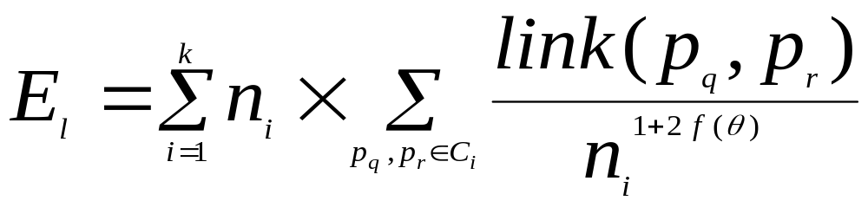
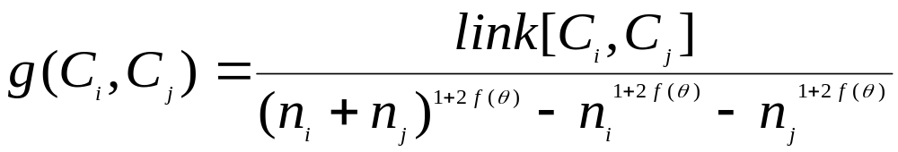
ROCK
Criterion Function
Goodness Function
Suppose in C_{i}, each point has roughly n_{i}^{f(θ)} neighbors.
The author’s choice for basket data is : f(θ)=(1-θ)/(1+θ)

Slide 13
ROCK
q[i]:local heap for C_{i},
q[i] contains every C_{j} such that link[C_{i}, C_{j}]>0, and C_{j} in q[i] are ordered in the decreasing order of the goodness function g(C_{i}, C_{j})
Q: global heap for all clusters,
  Clusters in Q are ordered in the decreasing order of
  g(C_{i}, max(q[i]))

Slide 14
ROCK
Algorithm
Cluster(S, k)
link=compute_links(S)
for each s in S do
q[s]=build_local_heap(link, s)
Q=build_global_heap(S, q)
while |Q|>k do {
u=extract_max(Q)
v=max(q[u])
w=merge(u, v)
for x in (q[u] or q[v])
update(link, q,Q, u, v, w)
}

Slide 15
ROCK
Time and Space complexity
  Time complexity
    Compute link: O(n^{2.37}) by using matrix multiplication or O(nm_{m}m_{a}), (m_{a} and m_{m} denotes the average and maximum number of neighbors of a point respectively)
    Compute heap: O(n) to build a heap, so totally O(n²) to build all heaps
    While loop carries on for n times, each time the inner for loop is for O(nlog^{n})
    Totally O(n² + nm_{m}m_{a}+ n² nlog^{n})
  Space complexity
    O(min{(n² , nm_{m}m_{a} }), entirely depends on the local heap size.

Slide 16
ROCK
Miscellaneous Issues
  Random Sampling can be used
  Handling Outliers
    Discard those points with no or few neighbors
    Stop at a certain step to remove clusters with every few objects.

Slide 17
Experiments
Three sets of real data compared with traditional hierarchical method.
  Congressional Votes
    Two clusters are well separated, results are similar
  Mushroom
    Clusters are not well separated, ROCK performs very well.
  US Mutual Funds (time series data)
    ROCK performs well, while traditional methods can not be used because the size variance of records is very large.

Slide 18
Question?

